Slide 1

Session 3 – Serial Communication
Using Serial Protocols – UART, I2C, SPI – to communicate with the arduino

Slide 2
Last Session
Signals are classed as either Analogue or Digital
Producing square waves:
To start up: tone(pin, freq);
To end: noTone(pin);
Digital inputs:
With pullup: pinMode(pin, INPUT_PULLUP);
Floating: pinMode(pin, INPUT);
Reading: digitalRead(pin);
Analogue pins - addressed A0 to A5
To read: analogRead(pin);
If statements: if(condition){ }
Else statement else can follow if, executes if condition false
Comparators ==, !=, >=, <=, >, <
! can be used as an operator for “not”
Switches suffer from switch bounce – debounce using hardware (capacitor) or software (millis() )

Slide 3
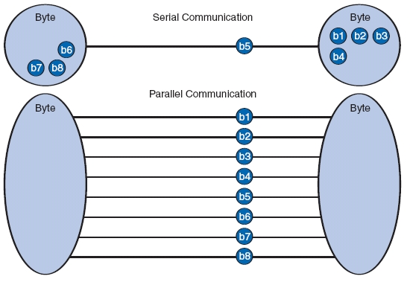
What is Serial?
How could we transfer 8 bits of data between two devices?
All bits in one go – parallel transmission
One bit at a time – serial transmission
Serial requires fewer connections between devices and is cheaper and easier to implement
Some common forms of serial data interfaces include SATA and USB
To communicate with the Arduino via the USB lead we use a serial protocol called UART
We can use this to send data to the PC too!

Slide 4
UART – Sending to PC
Connect the Arduino to your PC using the USB cable
Load this code onto your Arduino
Open the serial monitor – what do you notice?
Note the baud rate (9600Hz) must match the selection in the serial monitor
What if we put the println statement in the setup() function?
Can you make anything fun appear on the screen using loops and if statements?
void setup() {
Serial.begin(9600);
}
void loop() {
Serial.println("Hello world!");
}

Slide 5
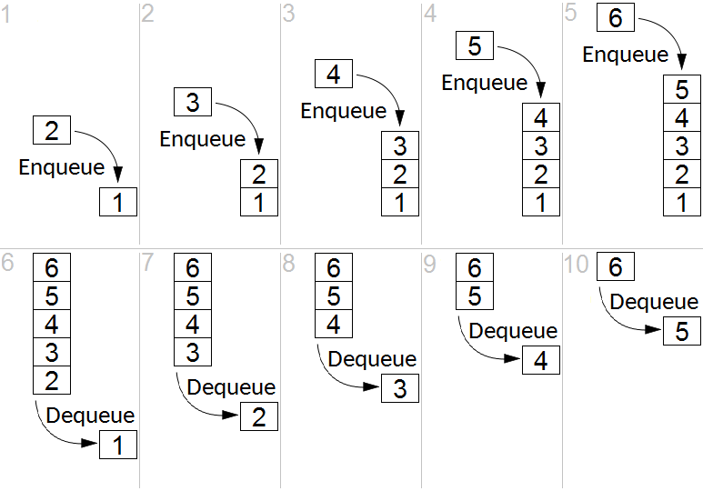
UART – Sending to the Arduino
You can type in the Serial Monitor to send messages and data to the Arduino
When you press enter, the characters are queued up in a buffer in the PC
The buffer is First-In, First-Out (FIFO) meaning that when data is sent to the Arduino, the first character typed will be the first to be sent
We can read data out of the buffer one byte (character) at a time using Serial.read()
As characters are read they are removed from the buffer

Slide 6
UART Example
println prints a new line at the end, whereas print doesn’t
!Serial.available() – “serial not available”
Serial.available() tells us how many characters are available to read
New variable type – char
Serial.read() reads the character at the end of the buffer and removes it
A for loop is used to work through the buffer contents
Could you make this work using Serial.readString() to read all characters in one go?
void setup() {
Serial.begin(9600);
}
void loop() {
Serial.println("Hello! What's your name?");
while ( !Serial.available() ) {}
delay(100);
Serial.print("Hello there ");
int i;
for( i=Serial.available(); i>0; i-- ) {
char input = Serial.read();
Serial.print(input);
}
Serial.println("!");
}

Slide 7
Binary – A Quick Introduction
Binary is base 2 – it consists only of 0s and 1s
Useful for electronics as we can represent it as “on” or “off” – HIGH or LOW
For example, the byte 11001011 is equal to 203
One binary digit is a bit, four is a nibble, eight is a byte and sixteen is a word (for the Arduino)
Place Value (n) | 7 | 6 | 5 | 4 | 3 | 2 | 1 | 0
Decimal Value 2^{n} | 128 | 64 | 32 | 16 | 8 | 4 | 2 | 1
X | 1 | 1 | 0 | 0 | 1 | 0 | 1 | 1

Slide 8
Binary Shift Operators
It can be useful to shift binary words “left” and “right”
Shift-Left and Shift-Right are executed using the operators << and >> respectively
Shifting left doubles the number for each bit shift and shifting right halves for each bit shift
For example, 100₂ << 1 = 1000₂ - so 4 has been doubled to 8
Also, 1100₂ >> 2 = 11₂ – so 12 has been divided by four and is now 3
This might seem random, but we’re about to use it!
Operation | 128 | 64 | 32 | 16 | 8 | 4 | 2 | 1
 | 1 | 0 | 0 | 1 | 1 | 1 | 1 | 1
>> 2 | 0 | 0 | 1 | 0 | 0 | 1 | 1 | 1
<< 3 | 0 | 0 | 1 | 1 | 1 | 0 | 0 | 0

Slide 9
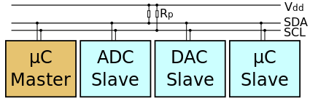
I²C – Inter-Integrated Circuit
Referred to as a “Two – Wire Interface”
A serial communication protocol that behaves more like a computer network than UART
Connects multiple devices using a Serial Data (SDA) and Serial Clock (SCL) line
All devices have an address and are either a master (controller) or slave device
We will be using the Wire library to control the I²C functions of the Arduino
We will communicate with a LM75A temperature sensing chip

Slide 10
LM75A I²C Temperature Sensor
The LM75A temperature sensor sends information about temperature as two bytes of data - we can only read one byte at a time over the I²C serial line, so we’ll need to do two read operations and manipulate the readings to get the answer
Note that there’s only 11 useful bits of information – we will read byte 1, shift left by 8, add byte 2 and then shift right by 5 to get the useful information out
Byte/bit | 7 | 6 | 5 | 4 | 3 | 2 | 1 | 0
Byte 1 | T10 | T9 | T8 | T7 | T6 | T5 | T4 | T3
Byte 2 | T2 | T1 | T0 | X | X | X | X | X
Operation | 15 | 14 | 13 | 12 | 11 | 10 | 9 | 8 | 7 | 6 | 5 | 4 | 3 | 2 | 1 | 0
Read byte 1 | 0 | 0 | 0 | 0 | 0 | 0 | 0 | 0 | T10 | T9 | T8 | T7 | T6 | T5 | T4 | T3
<< 8 | T10 | T9 | T8 | T7 | T6 | T5 | T4 | T3 | 0 | 0 | 0 | 0 | 0 | 0 | 0 | 0
Add byte 2 | T10 | T9 | T8 | T7 | T6 | T5 | T4 | T3 | T2 | T1 | T0 | X | X | X | X | X
>> 5 | 0 | 0 | 0 | 0 | 0 | T10 | T9 | T8 | T7 | T6 | T5 | T4 | T3 | T2 | T1 | T0

Slide 11
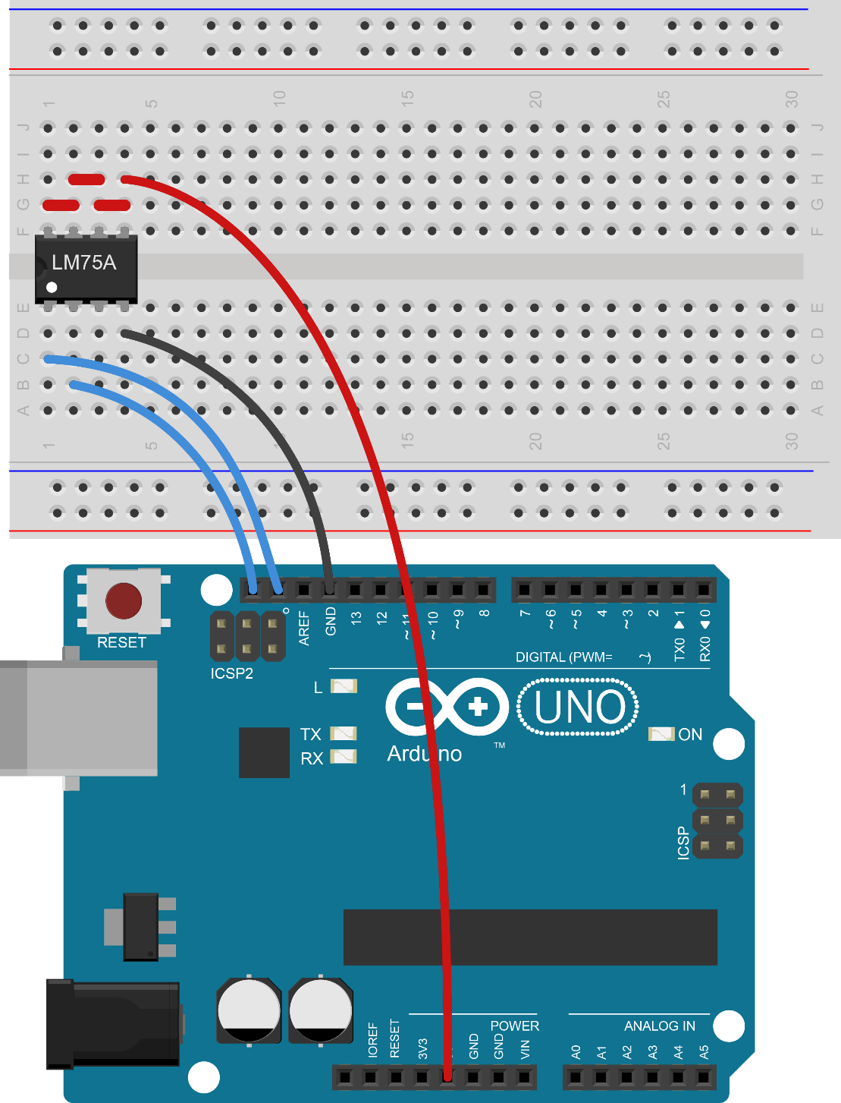
Connecting the LM75A
Connect the LM75A as shown here
Make sure that you have it the right way up – with the dot/notch on the left!
Connect all the top pins to +5V (Note: we’ve connected these together for you!)
Connect the bottom right pin to 0V
Connect SDA and SCL as shown

Slide 12
I²C Code Example
Using a library – #include <Wire.h>
Address of the LM75A (79) made constant using const
Start Wire using Wire.begin()
Request two bytes from the LM75A using Wire.requestFrom(address, bytes)
Read the bytes using Wire.read()
Multiply temperature by 0.125 to give temperature in degrees Celsius and print to serial
Could you do the last 5 lines of code in a single line?
#include <Wire.h>
const int address = 79;
void setup() {
Serial.begin(9600);
Wire.begin();
}
void loop() {
Wire.requestFrom(address, 2);
word temp = Wire.read();
temp = temp << 8;
temp = temp + Wire.read();
temp = temp >> 5;
Serial.println(temp*0.125);
}

Slide 13
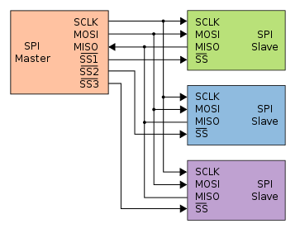
SPI – Serial Peripheral Interface
Referred to as a “Four – Wire Interface”
Another serial data protocol that only allows a single master device controlling slave devices
The active slave device is chosen by enabling its Slave Select (SS) pin
Data is transferred when pulses are placed on the clock line (SCLK)
There are two separate unidirectional lines – MOSI (Master-Out, Slave-In) and MISO (Master-In, Slave-Out)
This requires more connections but is simpler to implement manually
We can use the SPI library – but it can look confusing!

Slide 14
TC77 Microwire Temperature Sensor
The TC77 sensors actually use a protocol called Microwire – which is similar to normal SPI, but uses a single serial data line (SI/O) instead of the two MISO and MOSI lines.
We only need to send information from the TC77 to the Arduino – we’ll just treat SI/O as the MISO line and ignore the MOSI line
The TC77 sends 16 bits on its SI/O line - for SPI there would be 16 clock pulses on the SCLK line, and 16 bits would be simultaneously transferred in both directions on the MISO and MOSI lines
Like the LM75A sensor, some of the transmitted bits are useless – we can discard the last 3 bits
Each time we want to read, we’ll enable the TC77 by pulling SS low, start the SPI transaction, read 16 bits, end the transaction and then disable the chip again

Slide 15
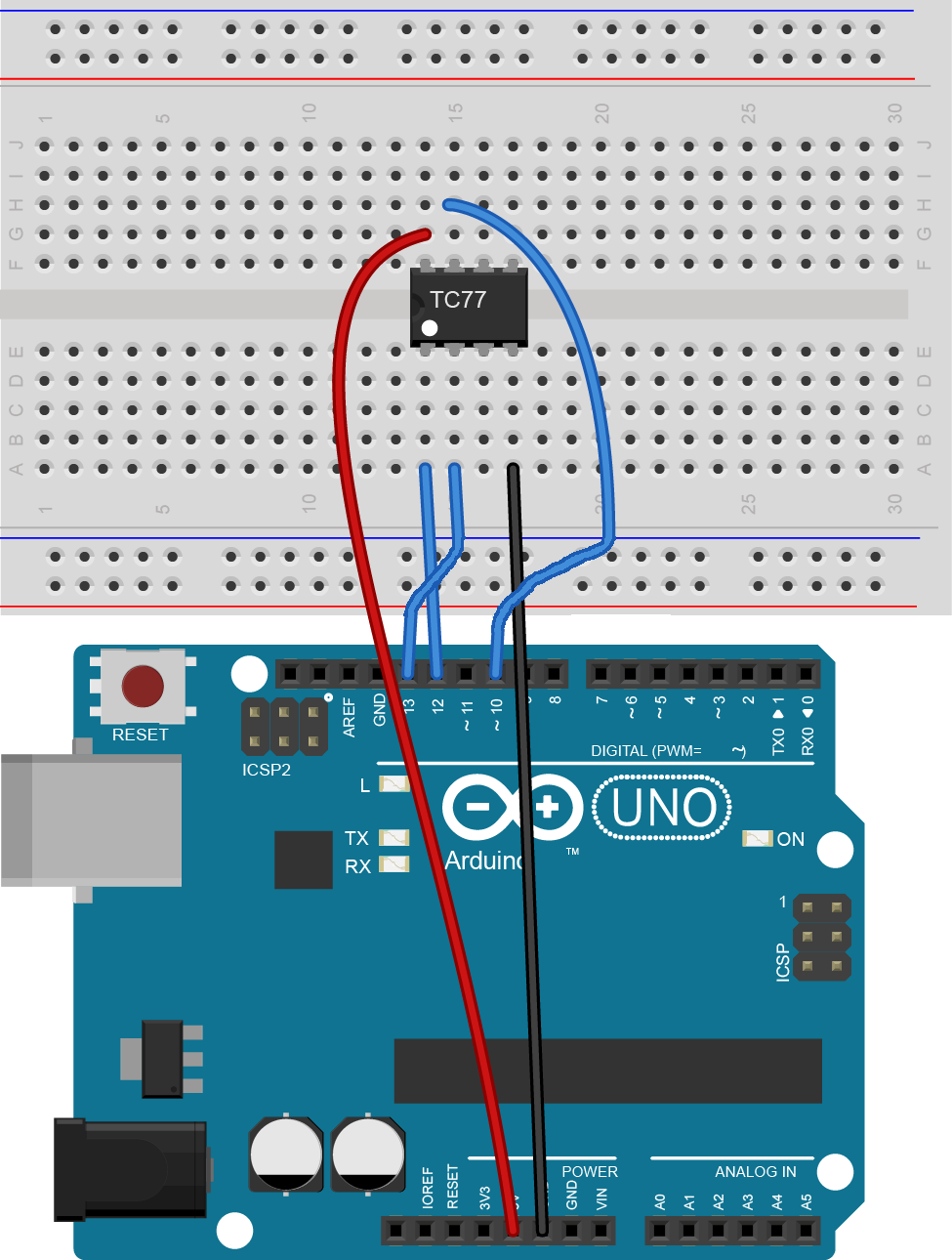
Connecting the TC77
Make sure that you have the TC77 the right way up – with the dot/notch on the left!
Connect the top left pin to +5V
Connect the bottom right pin to 0V
Connect SS (second top left) to pin 10
Connect SI/O (bottom left) to MISO (pin 12)
Connect SCLK (second bottom left) to pin 13

Slide 16
SPI Code Example
SPI.begin() to start the SPI
Using a digitalWrite to control the SS pin (active-low so enabled when LOW)
Startup SPI session using SPI.beginTransaction() and end with SPI.endTransaction() – don’t worry about what the SPISettings do for now
Transfer a word of data using SPI.transfer16() –the zero is the data sent on MOSI (irrelevant)
Adjust temp before printing to serial to convert to degrees Celsius
#include <SPI.h>
const int ss = 10;
void setup() {
Serial.begin(9600);
SPI.begin();
pinMode(ss, OUTPUT);
digitalWrite(ss, HIGH);
}
void loop() {
digitalWrite(ss, LOW); //Chip Enable
SPI.beginTransaction( SPISettings(7000000, MSBFIRST, SPI_MODE3) );
word temp = SPI.transfer16(0); //Read Data
SPI.endTransaction();
digitalWrite(ss, HIGH); //Chip Disable
temp = temp >> 3;
Serial.println(temp*0.0625);
}

Slide 17
Plenary
UART Serial
Start using Serial.begin(baud);
Print using Serial.print(); and Serial.println();
Check buffer using Serial.available();
Read from the PC using Serial.read(); and Serial.readString();
Binary operators
Shift left <<
Shift right >>
Including libraries: #include <library.h>
I²C library – Wire
Start using Wire.begin();
Request data: Wire.requestFrom(address, bytes);
Read a byte: Wire.read();
SPI library - SPI
Start using SPI.begin();
Start transmission: SPI.beginTransaction();
Settings: SPISettings(freq, order, mode);
Transfer word: SPI.transfer16(output);
End transmission: SPI.endTransaction();

Slide 18
Final Challenges
Try some of the following:
Report the analogue value of a potentiometer in the Serial Monitor
Make a “touch” detector to detect the warmth of a finger
Make an RGB LED fade red to blue depending on the temperature
Try “bit-banging” the Microwire transmission protocol on the Arduino to communicate with the TC77 temperature sensor (ask only if you’re keen!)

